Slide 1
Supermarket Analysis
Microsoft SQL

Slide 2
Data Overview

Slide 3
Data Overview
Column Names
Data Types
Invoice ID
Branch
City
Customer Type
Gender
Product Line
Unit Price
Quantity
Tax 5%
Total
Date
Time
Payment
Cogs
Gross Margin Percentage
Gross Income
Rating
Varchar
Char
Varchar
Varchar
Char
Varchar
Float
Integer
Float
Float
Date
Date/Time
Float
Float
Float
Float
Float

Slide 4
Project Goals
Analyzing Trend
Determining Popular Products
Understanding Impact of Sales
Identifying Valuable Customers
Analysing customer ratings

Slide 5

Project Steps
Connect
Connect the Database for retrieval of data
Clean
Remove Nan and Null values from the data that is unnecessary
Pre-process
Convert & Handle Missing Values
Analyze
Exploratory Analysis to get insights on the data

Slide 6

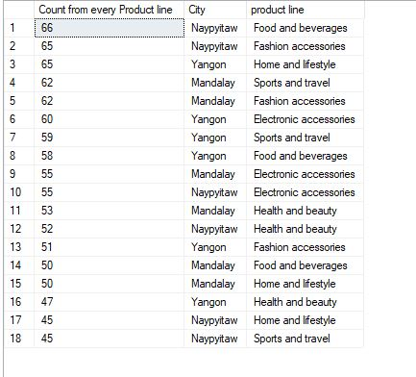
Analyzing the sales trend on the data
Analyzing the trend using​ Product line & City Columns`
select count("Invoice ID" )as "Number of Customers", City, "Product line" from supermarket group by "Product line","City" order by COUNT("Invoice ID") desc;

Slide 7
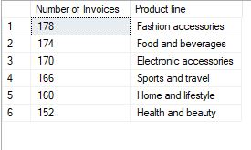
Determining most popular product
Analyzing the trend using​ Product line
select COUNT("Invoice ID") as "Number of Invoices" , "Product line" from supermarket group by "Product line" order by COUNT("Invoice ID") desc;

Slide 8

Impact of Pricing on Sales
Calculate the impact of pricing on sales
declare @R1 float
declare @R2 float
declare @R3 float
declare @R4 float
set @R1 = (select COUNT("Invoice ID") from supermarket where (convert(float,"unit price") between 0 and 25))
set @R2 = (select COUNT("Invoice ID") from supermarket where (convert(float,"unit price") between 26 and 50))
set @R3 = (select COUNT("Invoice ID") from supermarket where (convert(float,"unit price") between 51 and 75))
set @R4 = (select COUNT("Invoice ID") from supermarket where (convert(float,"unit price") between 76 and 100))
select @R1 as "Unit Price between 0-25", @R2 as "Unit Price between 25-50" ,@R3 as "Unit Price between 50-75", @R4 as "Unit Price between 75-100";

Slide 9

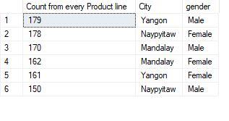
Identify the most valuable customers using SQL queries
Analyzing the most valuable customers
select sum(convert(float,total)) as "Sum of Total" , "City" , "gender" from supermarket group by "City","gender" order by sum(convert(float,total)) desc;

Slide 10

Effect of customer ratings on sales
Calculate the effect of customer ratings on sales
declare @Q1 float
declare @Q2 float
declare @Q3 float
declare @Q4 float
set @Q1 = (select sum(convert(float,"Total")) from supermarket where (convert(float,"rating") between 0 and 2.5))
set @Q2 = (select sum(convert(float,"Total")) from supermarket where (convert(float,"rating") between 2.6 and 5.0))
set @Q3 = (select sum(convert(float,"Total")) from supermarket where (convert(float,"rating") between 5.1 and 7.5))
set @Q4 = (select sum(convert(float,"Total")) from supermarket where (convert(float,"rating") between 7.6 and 10.0))
select @Q1 as "Rating between 0-2.5", @Q2 as "Rating between 2.6-5.0" ,@Q3 as "Rating between 5.1-7.5", @Q4 as "Rating between 7.6-10.0"

Slide 11
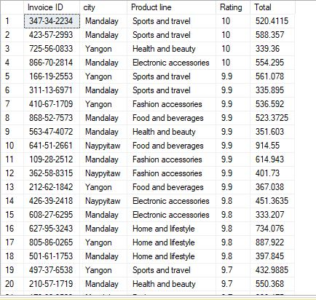
Average Customers over 5 Rating & Total of 500 spent
Calculating the top customers who spent over 500 and gave the highest rating
declare @AOR float
declare @AOT float
set @AOR = (select AVG(CONVERT(float,rating)) from supermarket)
set @AOT = (select AVG(convert(float,total)) from supermarket)
select ("Invoice ID") ,city , "Product line", CONVERT(float,rating) as Rating , convert(float,total) as Total from supermarket
where convert(float,rating) > @AOR and convert(float,total) >@AOT
order by rating desc;

Slide 12
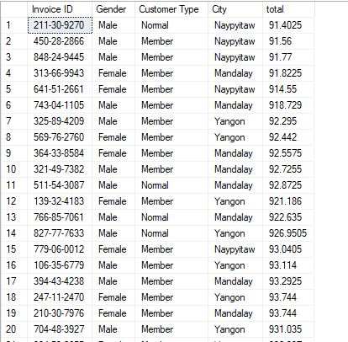
Top 50 customers who spent the most money
Calculating the top 50 customers
select "Invoice ID", Gender ,"Customer Type" , City , total from supermarket where total in (select top(50) total from supermarket order by total desc) ;

Slide 13



Summary
This analysis on the supermarket sales data gives us the insight about all the customers belonging from different cities like the product lines ,quantity of product they are interested in buying . This in-depth analysis help us understand the sales trend & customer behavior. we can gain insights into which products are selling the most, what factors influence sales, and which customers are the most valuable

Slide 14
Thank you

